Slide 1
Recommender Systems
Notes:
Recommendation systems are algorithms that analyze customer’s prior online behavior to make predictions about the preference of the user for an item

Slide 2
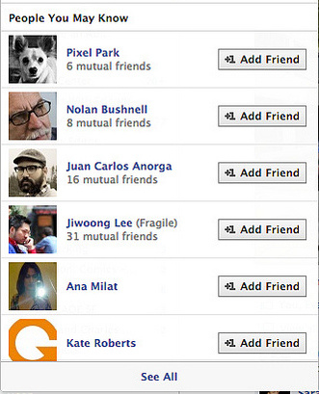
Facebook: “People You May Know”

Slide 3
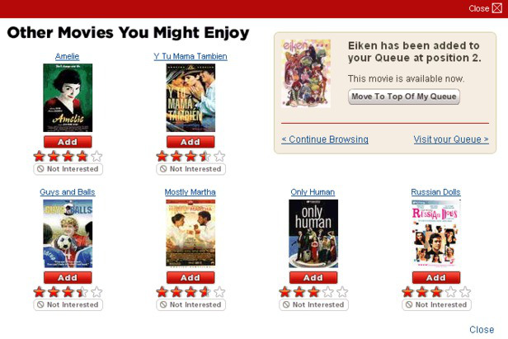
Netflix: “Other Movies You Might Enjoy”

Slide 4

LinkedIn: “Jobs You May be Interested In”

Slide 5
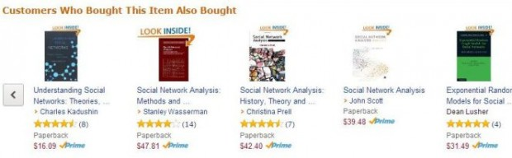
Amazon: “Customers Who Bought This Item Also Bought…

Slide 6
What are Recommender Systems?
Algorithms to mine patterns in huge datasets to learn and identify user behavior and filter out items that can be recommender to a user
Two elements of a recommender system – user & item
Users have preference for certain items – aim of the RS is to learn this preference

Slide 7
Why do we need Recommender System?
Long Tail Phenomenon
Item Popularity
Items

Slide 8
Types of RE
Recommender Engines
Content Based Filtering
Collaborative Filtering
Dimensionality Reduction Filtering
Recommendation is done based on the individual properties of the item. No comparison is made with other users/items
Recommendation is done based on similarity measures between other users and/or items
Recommendation is done based on reducing the dimensionality of the utility matrix
User Based Collaborative Filtering
Item Based Collaborative Filtering

Slide 9
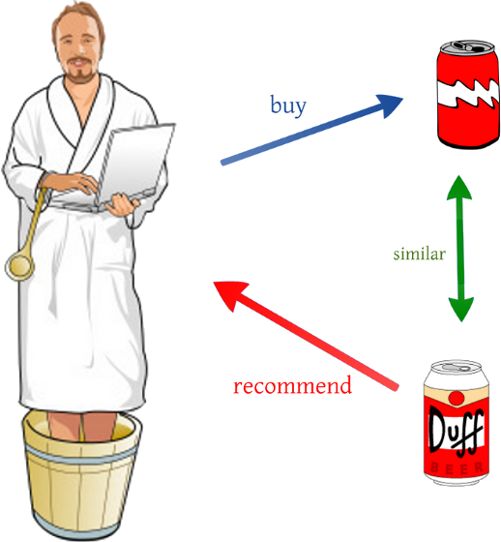
Content Based Filtering
Notes:
If a Netflix user has watched many cowboy movies, then recommend a movie classified in the database as having the “cowboy” genre

Slide 10
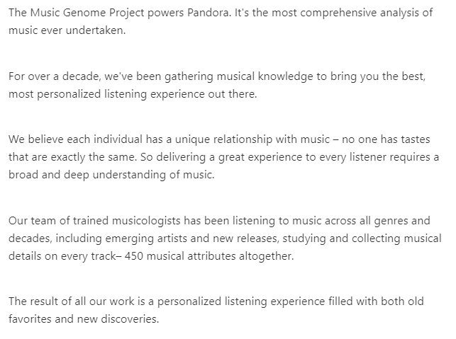

Content Based Filtering

Slide 11
Content Based Filtering
Constructs user-profile and item-profile using the content of shared attribute space
For example, for a movie, you represent it with the movie stars in it and the genres (using a binary coding for example)
For user profile, you can do the same thing based on whether the users likes some movie stars/genres etc.
Then the similarity of user and item can be computed using e.g., cosine similarity
Lets understand this through an example…

Slide 12
Content Based Filtering - Example
Suppose this is our user-profile (using binary encoding, 0 means not-like, 1 means like), which contains user's preference over 5 movie actors and 5 movie genres:
 | Johnny Depp | Al Pacino | Robert De Niro | Kevin Spacey | Russel Crowe | Action | Adventure | Comedy | Crime | War
User 1 | 0 | 0 | 0 | 1 | 1 | 1 | 1 | 1 | 0 | 0
User 2 | 1 | 1 | 0 | 0 | 0 | 0 | 0 | 0 | 1 | 1
User 3 | 0 | 0 | 0 | 1 | 1 | 1 | 1 | 1 | 1 | 0

Slide 13
Content Based Filtering - Example
Suppose this is our movie-profile:
 | Johnny Depp | Al Pacino | Robert De Niro | Kevin Spacey | Russel Crowe | Action | Adventure | Comedy | Crime | War
User 1 | 0 | 0 | 0 | 0 | 1 | 1 | 1 | 0 | 0 | 0
User 2 | 1 | 1 | 1 | 0 | 0 | 0 | 0 | 1 | 0 | 1
User 3 | 0 | 0 | 1 | 0 | 1 | 1 | 0 | 1 | 0 | 1

Slide 14
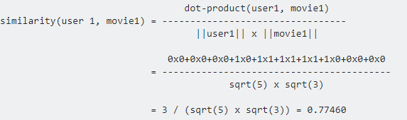
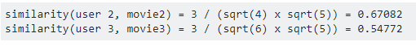
Content Based Filtering - Example
To calculate how good a movie is to a user, we use cosine similarity:
Similarly,
If you want to give one recommendation for user i, just pick movie j that has the highest similarity(i, j)
Notes:
We can use Jaccard Similarity as well

Slide 15
Issues with Content Based Filtering
Recommendation can be made only on items of the same type that the user has already used
For example, recommending music, videos, etc. based on the browsing pattern of news articles is not possible in Content Based Filtering
Also, it doesn’t scale well, as you need to create the attribute features for the items

Slide 16
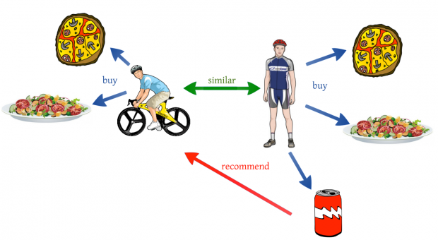
Collaborative Filtering
Notes:
This is an example of user based collaborative filtering

Slide 17
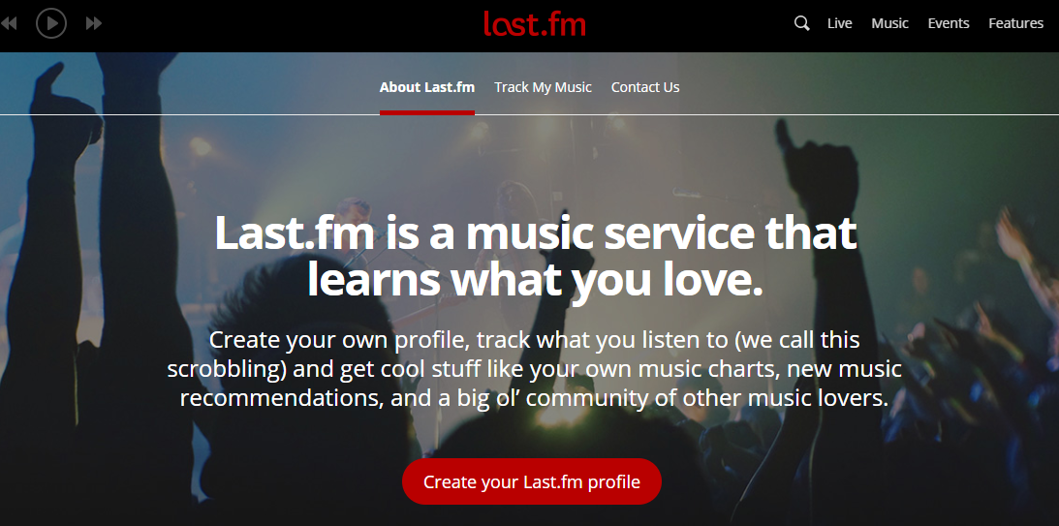
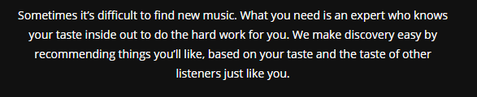
Collaborative Filtering

Slide 18
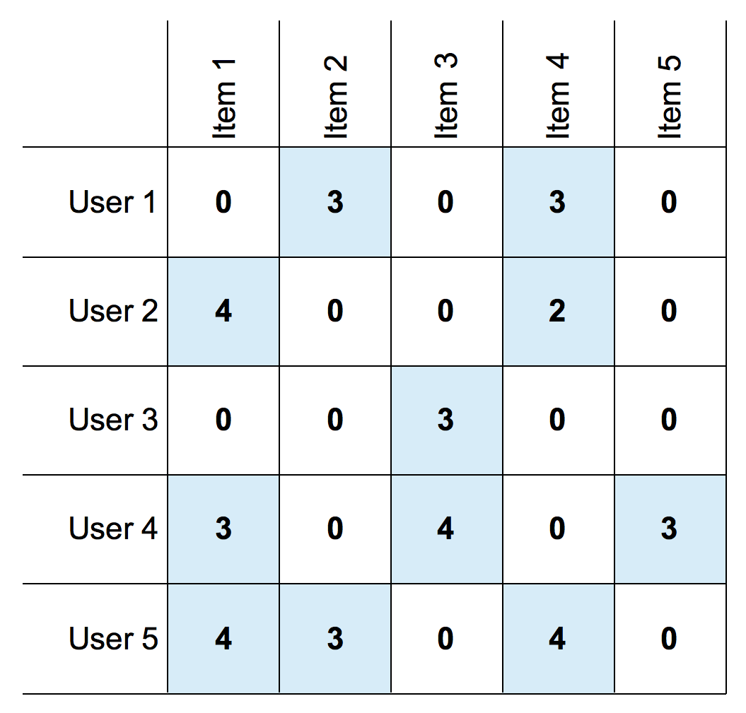
Collaborative Filtering
Collaborative Filtering
User Based Collaborative Filtering
Item Based Collaborative Filtering
Algorithm produces a rating for an item i by a user u by combining the ratings of other users u' that are similar to u
Produces a rating for i by u by looking at the set of items i' that are similar to i that u has rated and then combines the ratings by u of i' into a predicted rating by u for i.

Slide 19
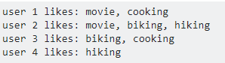
Item Based Collaborative Filtering
Similarity between items is computed based on the user ratings instead of the meta data of item content
Lets take an example. Suppose you have access to only some rating data like below:
Suppose now you want to make recommendations for user 4.

Slide 20
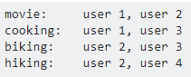
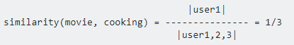
Item Based Collaborative Filtering
First you create an inverted index for items:
Since this is a binary rating (like or not), we can use a similarity measure like Jaccard Similarity to compute item similarity
|.| here denote the size of the set
Notes:
You just do the same thing for all possible item pairs (i,j)

Slide 21
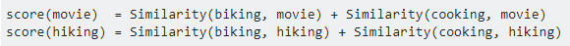
Item Based Collaborative Filtering
After you are done with the similarity computation for all pairs, say, you need to make a recommendation for user 4
Remember user 4 likes hiking
Look at the similarity score of similarity(hiking, x) where x is any other tags(items) you might have
If you need to make a recommendation for user 3, you can aggregate the similarity score from each items in its list. For example,
Notes:
Lets do these calculations

Slide 22
User Based Collaborative Filtering
UBCF considers similarity in User Behavior, instead of that in Items to make a recommendation
If User A ~ User B => Recommend Items that User A likes to User B
Remember in IBCF, we compute the similarity between items and not users

Slide 23
Collaborative Filtering
Data about a user’s preference can be collected using:
Explicit Methods
Implicit Methods
Explicit Methods may include:
Asking a user to rate an item on a sliding scale
Asking a user to search
Asking a user to rank a collection of items from favorite to least favorite
Presenting two items to a user and asking him/her to choose the better one of them
Asking a user to create a list of items that he/she likes
Implicit Methods may include:
Observing the items that a user views in an online store
Analyzing item/user viewing times
Keeping a record of the items that a user purchases online
Obtaining a list of items that a user has listened to or watched on his/her computer
Analyzing the user's social network and discovering similar likes and dislikes

Slide 24
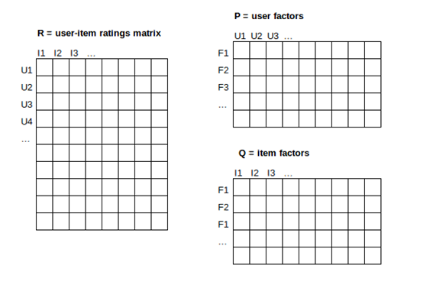
Dimensionality Reduction

Slide 25
Issues with Collaborative Filtering
Cold Start - requires a large amount of existing data on a user in order to make accurate recommendations
Sparsity - Even popular items generally have very few ratings
Scalability - millions of users and products. Large amount of computation power is often necessary to calculate recommendations

Slide 26
Dimensionality Reduction
UV-decomposition (instance of SVD)
Used to estimate the blank spaces in the sparse utility matrix
Assumption is that Utility Matrix ~ Product of two long, thin matrices

Slide 27
Dimensionality Reduction
Sparse Matrix M (n x m) = Matrix U (n x d) x Matrix V (d x m)
UV matrix is used to approximate blank entries in M
Both user and items can now be characterized using only d dimensions

